Slide 1
Computer Vision
Object Detection
Learning Outcomes
Understand the principles of people detection either from Single images or Videos
Be able to apply and evaluate different approaches of people detection

Slide 2
Outline
Motivation
People Detection
General Sliding window approach
Support vector machine detector
Viola-Jones cascade detector (focus)
HOG detector (focus)
Shapelet-based detector

Slide 3
Why is human detection important?
People are interesting and focus
Surveillance:
prosecution; intelligence gathering; crime prevention
HCI; architecture;
Synthesis
games; movies;
Biomechanics
spot diseases; learn new facts
movies; news

Slide 4
Challenges
• It is difficult to find people
Appearance
Pose
It is hard to track people in detail
Especially at a distance in most of the cases, and occluded
Small parts that move fast and unpredictably
It is hard to describe what they are doing
Behaviour composes
sometimes in complex ways
A canonical vocabulary is not known

Slide 5
People Detection
Classify a window as pedestrian or non-pedestrian
Search exhaustively the scale-space image

Slide 6
Summary of Static Detectors
Existing detectors
Support Vector Machine Detector
CONSTANTINE PAPAGEORGIOU AND TOMASO POGGIO. ‘A Trainable System for Object Detection’ (IJCV) 2000 38(1), 15–33.
Viola-Jones detector
P. Viola and M. Jones. Robust real-time face detection. International Journal of Computer Vision (IJCV) 57(2) 137-154, 2004. PDF. (Originally appeared in CVPR'01).
Histogram of Oriented Gradients Detector
Histograms of Oriented Gradients for Human Detection. Navneet Dalal and Bill Triggs. IEEE Conference on Computer Vision and Pattern Recognition (CVPR), vol. II, pages 886-893, June 2005.

Slide 7
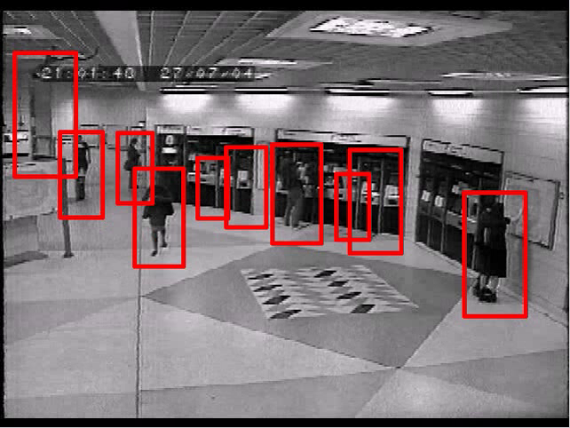
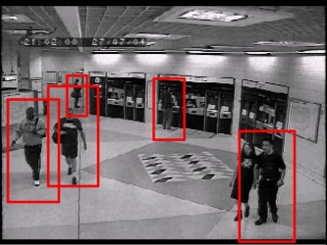
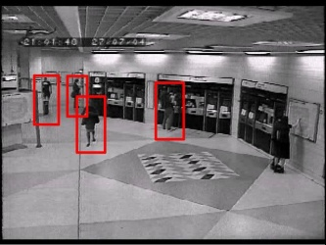
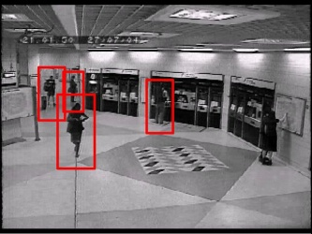
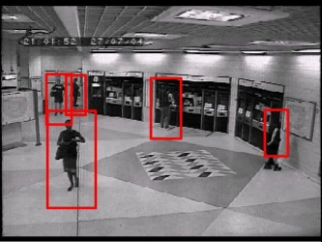
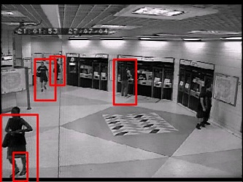
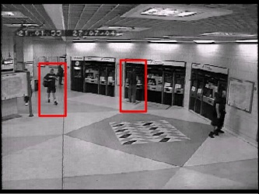
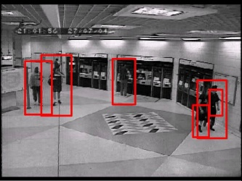
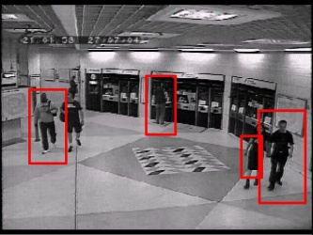
Object Detection
Single frame
Sliding windows
voting by parts
Video
Motion propagation
Tracking
Background extraction

Slide 8
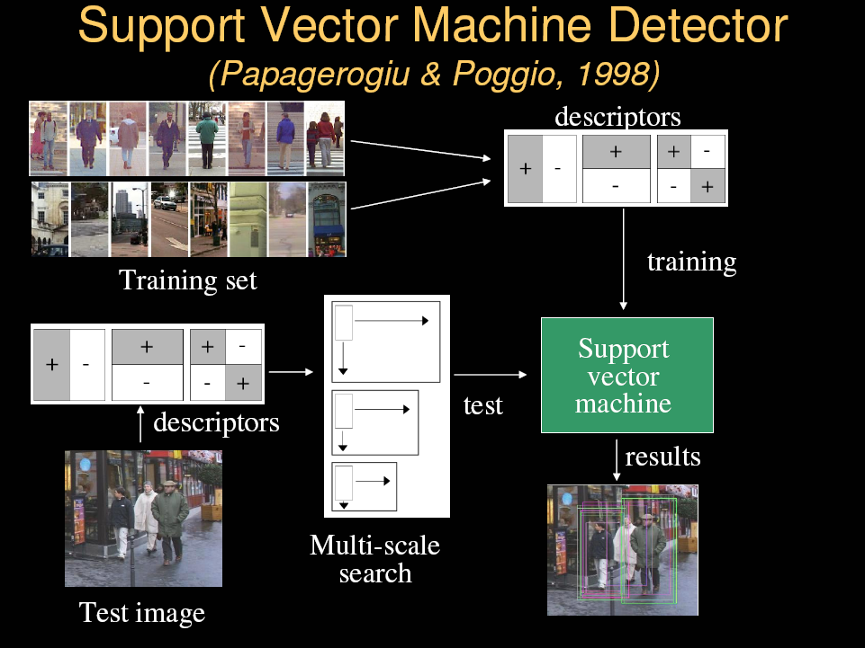
Slides from Sminchisescu

Slide 9
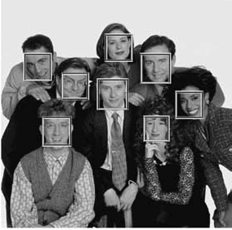
Robust Real-Time Face Detection
Viola and Jones – IJCV 2004

Slide 10
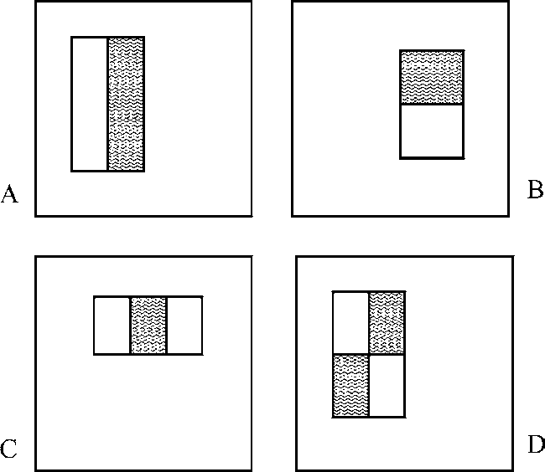
Harr-like Rectangle Features
Example rectangle features shown relative to the enclosing detection window. The sum of the pixels which lie within the white rectangles are subtracted from the sum of pixels in the grey rectangles. Two-rectangle features are shown in (A) and (B). Figure (C) shows a three-rectangle feature, and (D) a four-rectangle feature.

Slide 11
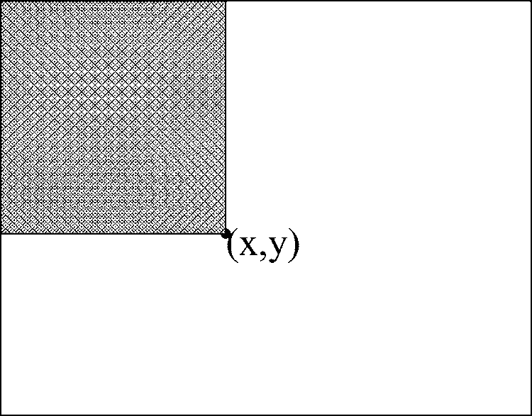
Integral Image
The value of the integral image at point (x, y) is the sum of all the pixels above and to the left.

Slide 12
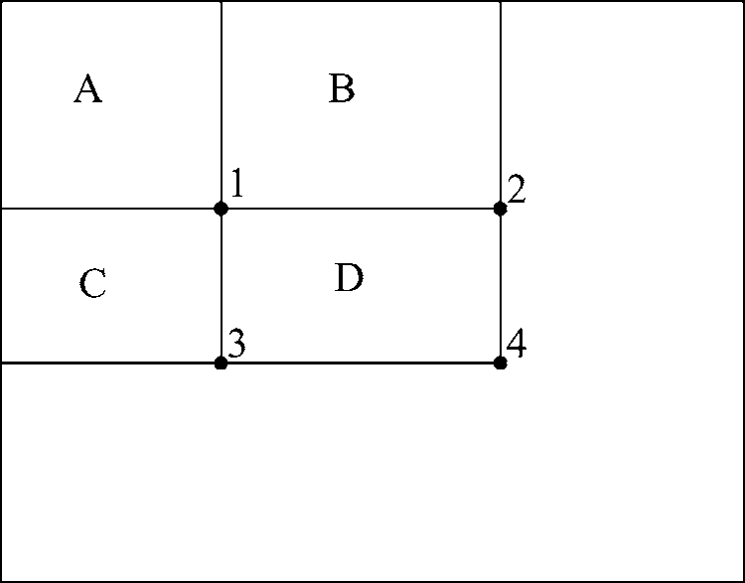
Integral Image
Using the integral image any rectangular sum can be computed in four array references
The sum of the pixels within rectangle D can be computed with four array references. The value of the integral image at location 1 is the sum of the pixels in rectangle A. The value at location 2 is A + B, at location 3 is A + C, and at location 4 is A + B + C + D. The sum within D can be computed as 4 + 1 − (2 + 3).

Slide 13
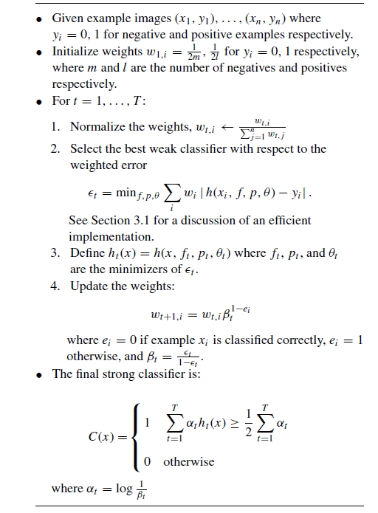
Classification-Traditional Boosting

Slide 14
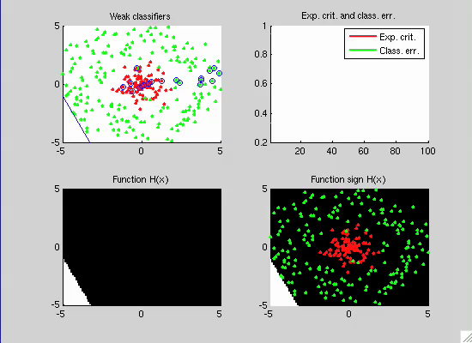
Adaboost Demo

Slide 15

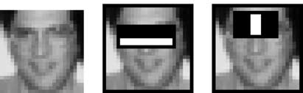
Features Selected by Adaboost
The first and second features selected by AdaBoost.

Slide 16
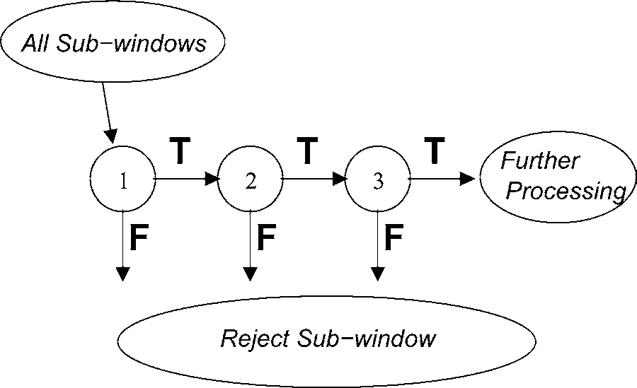
Attention Cascade
Schematic depiction of a detection cascade. A series of classifiers are applied to every sub-window. The initial classifier eliminates a large number of negative examples with very little processing. Subsequent layers eliminate additional negatives but require additional computation. After several stages of processing the number of sub-windows have been reduced radically. Further processing can take any form such as additional stages of the cascade (as in our detection system) or an alternative detection system.

Slide 17
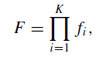
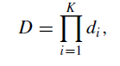
Training the Attention Cascade
False Positive Rate:
Detection Rate:
E.g, To achieve a detection rate of 0.9 of 10 stage, each stage has a detection rate 0.99.
Looks very hard for each stage?
But much easier if false positive rate is higher, e.g., 30%
Ideally, an optimal framework has to define:
The number of classifiers
The number of features, n(i) of each stage
The threshold of each stage

Slide 18
The Training Algorithm for Cascaded Detector
• User selects values for f , the maximum acceptable false positive rate per layer and d, the minimum acceptable detection rate per layer.
• User selects target overall false positive rate, F_target .
• P = set of positive examples
• N = set of negative examples
• F0 = 1.0; D0 = 1.0
• i = 0
• while Fi > F_target
– i ←i + 1
– ni = 0; Fi = Fi−1
– while Fi > f × Fi−1
∗ ni ← ni + 1
∗ Use P and N to train a classifier with ni features using AdaBoost
∗ Evaluate current cascaded classifier on validation set to determine Fi and Di .
∗ Decrease threshold for the ith classifier until the current cascaded classifier has a detection rate of at least d × Di−1 (this also affects Fi )
– N ← ∅
– If Fi > Ftarget then evaluate the current cascaded detector on the set of non-face images and put any false detections into the set N

Slide 19
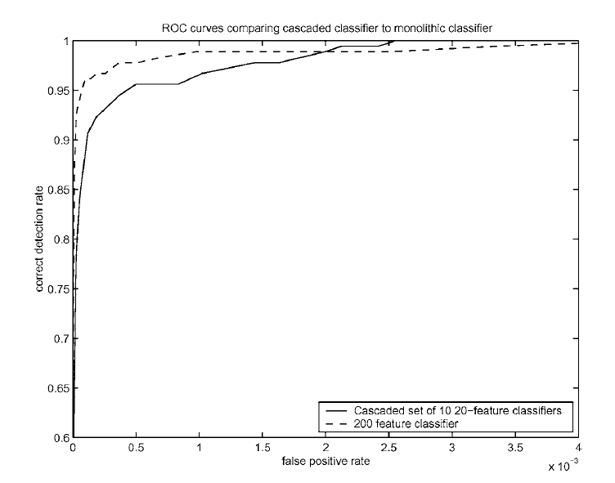
Performance: Cascade Vs. Non Cascade

Slide 20

Face Detection Results

Slide 21
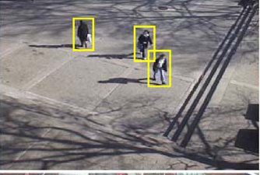
Dynamic Pedestrians Detection
Viola, Jones Snow ICCV 2003
Training Adaboost about 45,000 possible features
Efficient and reliable for distance detection (20x15) 4fps

Slide 22
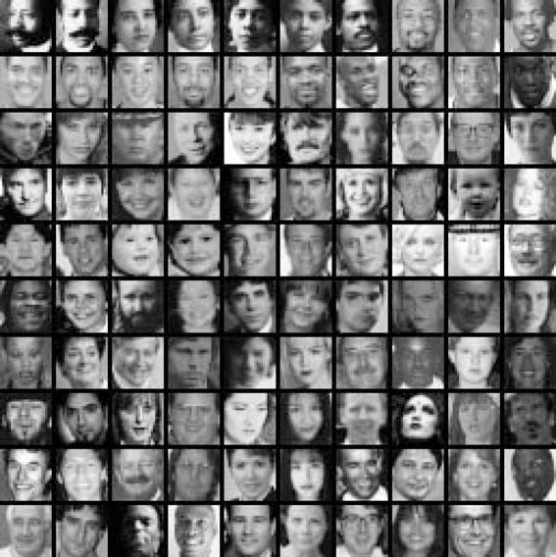
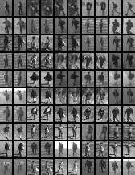
Pedestrian Detection (V-J)
Simply replace face training set with pedestrian training set:
Redo all of the training process: and more …

Slide 23
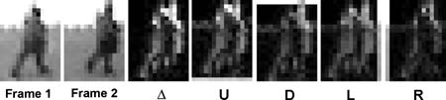
Extension of V-J for motion features
Appearance features: rectangular features extracted on each frame
Motion features: rectangular feature extracted on shifted difference images between two consecutive images
Delta = abs(It − It+1); U = abs(It − It+1 ↑); L = abs(It − It+1 ←); R = abs(It − It+1 →); D = abs(It − It+1 ↓)
Further Reading:
PAUL VIOLA, MICHAEL J. JONES AND DANIEL SNOW, Detecting Pedestrians Using Patterns of Motion and Appearance, International Journal of Computer Vision 63(2), 153–161, 2005

Slide 24
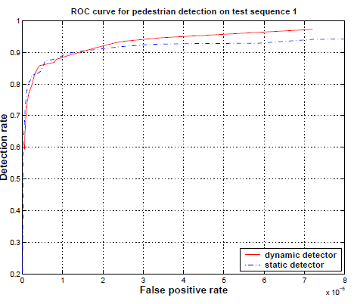
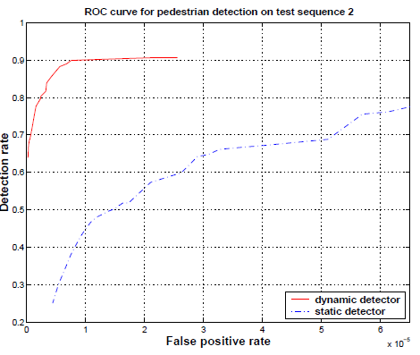
Pedestrian Detection (V-J)
Pedestrian Detection (V-J): Static < Dynamic

Slide 25
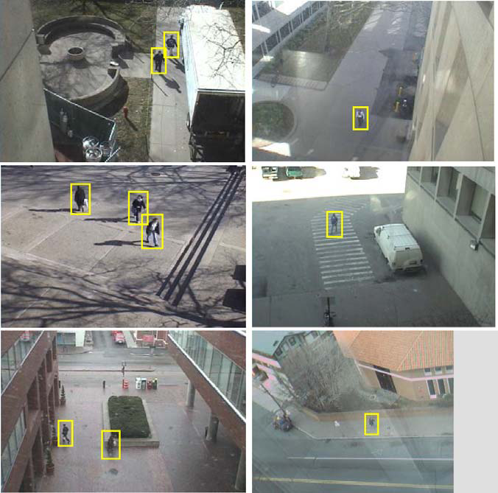
Pedestrian Detection (V-J)

Slide 26
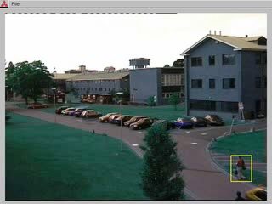
Detection Results Demo

Slide 27
Summary of V-J detector
Rectangular feature set is multi-scale and should be huge.
Efficient feature selection using AdaBoost
Integral Image (fast calculation)
Cascaded Classifier for rapid detection
Accuracy is comparable to other SVM detectors, but much faster

Slide 28
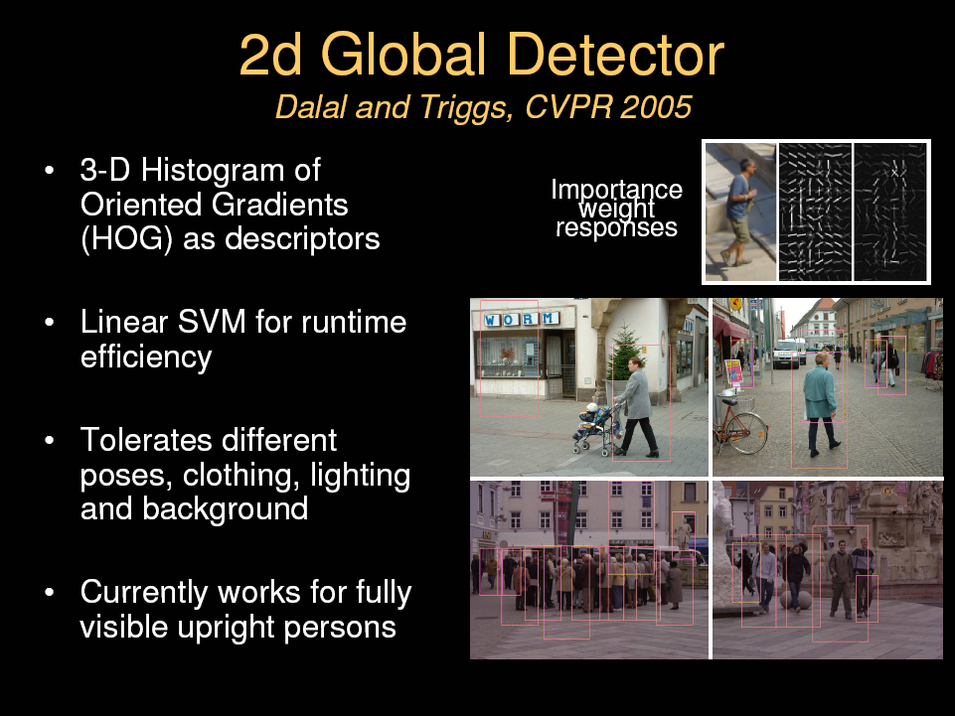
Slides from Sminchisescu

Slide 29
Feature Sets
Haar wavelets + SVM:
Papageorgiou & Poggio (2000)
Mohan et al (2001)
DePoortere et al (2002)
Rectangular differential features + adaBoost:
Viola & Jones(2001)
Parts based binary orientation position histogram + adaBoost:
Mikolajczk et al (2004)
Edge templates + nearest neighbor:
Gavrila & Philomen (1999)
Dynamic programming:
Felzenszwalb & Huttenlocher (2000),
Loffe & Forsyth (1999)
Orientation histograms:
C.F. Freeman et al (1996)
Lowe(1999)
Shape contexts:
Belongie et al (2002)
PCA-SIFT:
Ke and Sukthankar (2004)

Slide 30
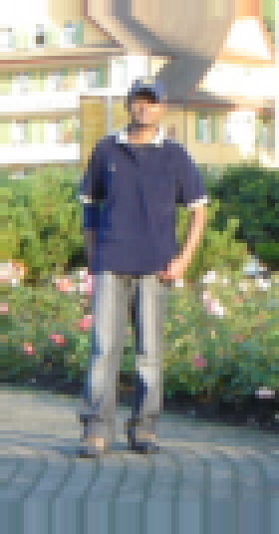
Histogram of Oriented Gradients

Slide 31
Gamma/Colour Normalisation
Tested with RGB, LAB, Grayscale
RGB = LAB > Grayscale:
Color information helps classification (+1.5%)
Gamma Normalization and Compression
Square root (+1% at 10-4 FPPW)|
Log (-2%)

Slide 32
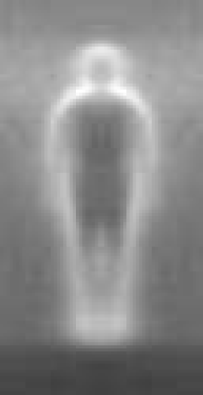

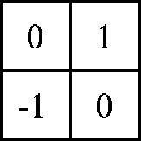

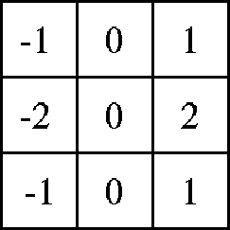

Gradient Computation
Centered (Best)
diagonal
uncentered
cubic-corrected
Sobel
Test : Gaussian Smoothing + discrete Derivative Masks
Larger masks seems decrease performance,

Slide 33
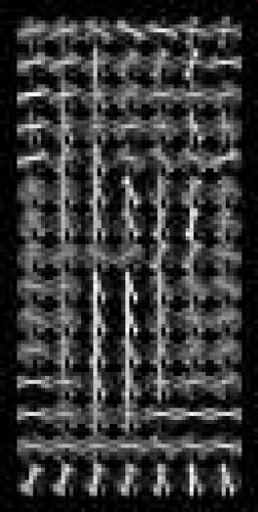
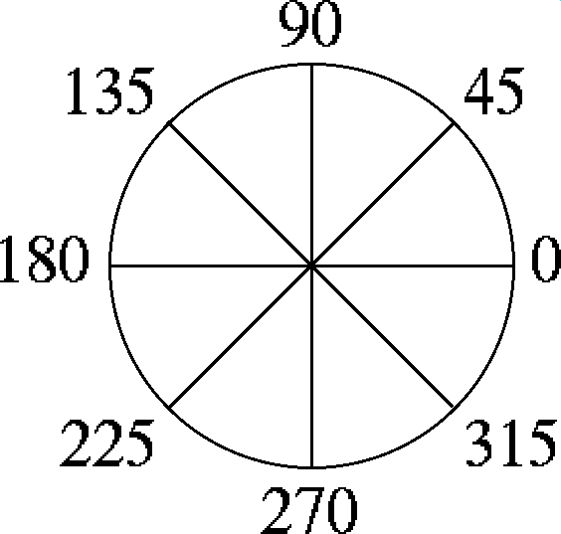
Orientation and Spatial Voting
Histogram of gradient orientations
-Orientation -Position
Weighted by magnitude

Slide 34
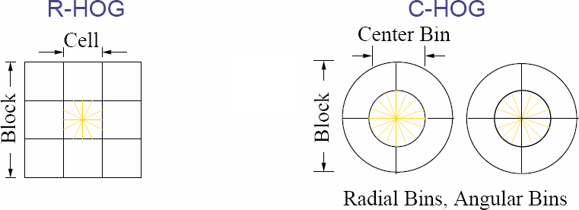
Orientation and Spatial Voting

Slide 35
Contrast Normalization
L2 norm > L1 Norm >> non norm

Slide 36
Whole Detector
Concatenate all of the cell vectors together

Slide 37
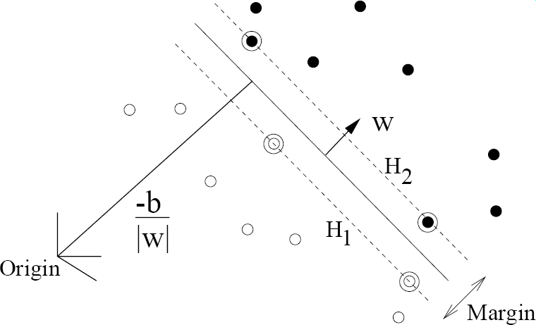
Training
Two Rounds of Training
Train a SVM with preselected positive and negative samples
Run the 1st SVM detector on a set of images and then use the false positives to retrain the SVM

Slide 38
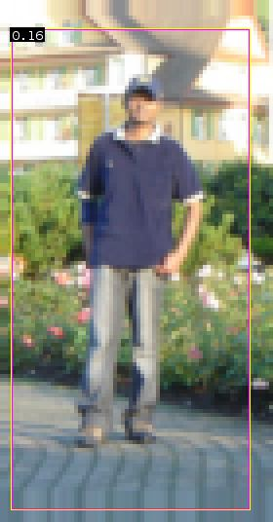
Sliding Detection
Messages:
Smoothing before gradients calculation could damage the HOG because much of the available pedestrian information is from abrupt edges at fine scales, bluring this in the hope of reducing the sensitivity to spatial position is a mistake.
Strong local contrast normalisation is essential for good results and traditional center-round style schemes are not the best choice. Better results can be obtained by normalising each element several times to different local supports.

Slide 39
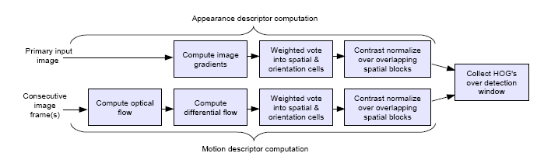
HOG Extensions
1) Handling the moving background issues
2) Better performance than static detectors when on videos
References: Navneet Dalal and Bill Triggs and Cordelia Schmid, "Human detection using oriented histograms of flow and appearance", "European Conference on Computer Vision", 2006

Slide 40
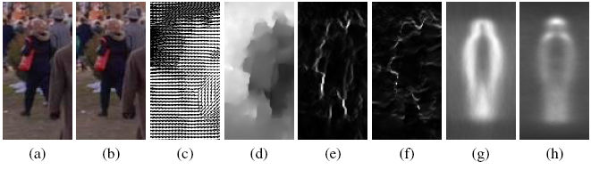
Histogram of Optical Flow
Illustration of the MBH descriptor. (a,b) Reference images at time t and t+1. (c,d) Computed optical flow, and flow magnitude showing motion boundaries. (e,f) Gradient magnitude of flow field Ix, Iy for image pair (a,b). (g,h) Average MBH descriptor over all training images for flow field Ix, Iy.

Slide 41
HOG vs. SIFT (Lowe04 IJCV)
Common Features (Lessons learnt)
Local Histogram for Oriented Gradients
Geometrical Partition of Local Patches
Both of them are very well engineered
Differences
Engineered for different goals (Human vs.Generic object class recognition)
Uniform sampling vs. Key points
Fine orientation binning (9 bins/180^{O} vs. 8 bins/360^{O)}
Larger cell (6-8 pixels) vs. 4 pixels

Slide 42
What We Have Learnt Today
Different People Detectors
V-J detector
Real time performance, why?
Can be made for video by frame differencing.
HOG Detector
Very high accuracy
Could be made faster in the V-J fashion (self reading).
Can be made for video by optical flow.

Slide 43
Computer Vision
Object Detection
Learning Outcomes
Understand the principles of people detection either from Single images or Videos
Be able to apply and evaluate different approaches of people detection

